Slide 1
Programming Paradigm
Module 1

Slide 2
Reasons for Studying Concepts of Programming Languages

Slide 3
Language constructs can be simulated in other languages that do not support those constructs directly.
For example, a C programmer who had learned the structure and uses of associative arrays in Perl might design structures that simulate associative arrays in that language.

Slide 4
Improved background for choosing appropriate languages
Many programmers, when given a choice of languages for a new project, use the language with which they are most familiar, even if it is poorly suited for the project at hand.
If these programmers were familiar with a wider range of languages and language constructs, they would be better able to choose the language with the features that best address the problem.
Some of the features of one language often can be simulated in another language.
However, it is preferable to use a feature whose design has been integrated into a language than to use a simulation of that feature, which is often less elegant, more cumbersome, and less safe

Slide 5
Increased ability to learn new languages.
Computer programming is still a relatively young discipline, and design methodologies, software development tools, and programming languages are still in a state of continuous evolution.
This makes software development an exciting profession, but it also means that continuous learning is essential.
The process of learning a new programming language can be lengthy and difficult, especially for someone who is comfortable with only one or two languages and has never examined programming language concepts in general.

Slide 6
Once a thorough understanding of the fundamental concepts of languages is acquired, it becomes far easier to see how these concepts are incorporated into the design of the language being learned.
For example, programmers who understand the concepts of object-oriented programming will have a much easier time learning Java than those who have never used those concepts
The TIOBE Programming Community issues an index that is an indicator of the relative popularity of programming languages.

Slide 7
For example, according to the index, Java, C, and C++ were the three most popular languages in use in August 2011.
The index data also show that the distribution of usage of programming languages is always changing.
The number of languages in use and the dynamic nature of the statistics imply that every software developer must be prepared to learn different languages

Slide 8
Better understanding of the significance of implementation
An understanding of implementation issues leads to an understanding of why languages are designed the way they are.
In turn, this knowledge leads to the ability to use a language more intelligently, as it was designed to be used.
We can become better programmers by understanding the choices among programming language constructs and the consequences of those choices.

Slide 9
Certain kinds of program bugs can be found and fixed only by a programmer who knows some related implementation details.
Another benefit of understanding implementation issues is that it allows us to visualize how a computer executes various language constructs.
In some cases, some knowledge of implementation issues provides hints about the relative efficiency of alternative constructs that may be chosen for a program.
For example, programmers who know little about the complexity of the implementation of subprogram calls often do not realize that a small subprogram that is frequently called can be a highly inefficient design choice.

Slide 10
Better use of languages that are already known.
It is uncommon for a programmer to be familiar with and use all of the features of a language he or she uses.
By studying the concepts of programming languages, programmers can learn about previously unknown and unused parts of the languages they already use and begin to use those features.

Slide 11
Overall advancement of computing
Although it is usually possible to determine why a particular programming language became popular, many believe, at least in retrospect, that the most popular languages are not always the best available.
In some cases, it might be concluded that a language became widely used, at least in part, because those in positions to choose languages were not sufficiently familiar with programming language concepts.
For example, many people believe it would have been better if ALGOL 60 had displaced Fortran in the early 1960s, because it was more elegant and had much better control statements, among other reasons.

Slide 12
That it did not, is due partly to the programmers and software development managers of that time, many of whom did not clearly understand the conceptual design of ALGOL 60.
They found its description difficult to read (which it was) and even more difficult to understand. They did not appreciate the benefits of block structure, recursion, and well-structured control statements, so they failed to see the benefits of ALGOL 60 over Fortran

Slide 13
Programming Domains

Slide 14
Scientific Applications
The first digital computers, which appeared in the late 1940s and early 1950s, were invented and used for scientific applications.
Typically, the scientific applications of that time used relatively simple data structures, but required large numbers of floating-point arithmetic computations.
The most common data structures were arrays and matrices; the most common control structures were counting loops and selections.
The early high-level programming languages invented for scientific applications were designed to provide for those needs.
Eg: FORTRAN,ALGOL 60

Slide 15
Business Applications
The use of computers for business applications began in the 1950s.
Special computers were developed for this purpose, along with special languages
The first successful high-level language for business was COBOL
Business languages are characterized by facilities for producing elaborate reports, precise ways of describing and storing decimal numbers and character data, and the ability to specify decimal arithmetic operations.

Slide 16
Artificial intelligence (AI)
Artificial intelligence (AI) is a broad area of computer applications characterized by the use of symbolic rather than numeric computations.
Symbolic computation means that symbols, consisting of names rather than numbers, are manipulated.
Also, symbolic computation is more conveniently done with linked lists of data rather than arrays.
This kind of programming sometimes requires more flexibility than other programming domains.
For example, in some AI applications the ability to create and execute code segments during execution is convenient Eg: LISP,Prolog, C

Slide 17
Systems Programming
The operating system and the programming support tools of a computer system are collectively known as its systems software.
Systems software is used almost continuously and so it must be efficient.
It must have lowlevel features that allow the software interfaces to external devices to be written.
For IBM mainframe computers, the language was PL/S, a dialect of PL/I;
for Digital, it was BLISS, a language at a level just above assembly language; for Burroughs, it was Extended ALGOL.
However, most system software is now written in more general programming languages, such as C and C++

Slide 18
The UNIX operating system is written almost entirely in C,which has made it relatively easy to port, or move, to different machines

Slide 19
Web Software
The World Wide Web is supported by an eclectic collection of languages, ranging from markup languages, such as HTML, which is not a programming language
Because of the pervasive need for dynamic Web content, some computation capability is often included in the technology of content presentation.
This functionality can be provided by embedding programming code in an HTML document.
Such code is often in the form of a scripting language, such as JavaScript or PHP.

Slide 20
Language Evaluation Criteria
Readability : the ease with which programs can be read and understood
Writability : the ease with which a language can be used to create programs
Reliability : conformance to specifications (i.e., performs to its specifications)
Cost : the ultimate total cost

Slide 21
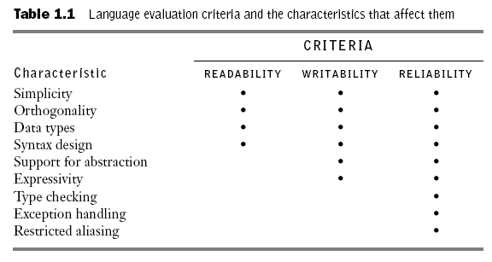

Slide 22
Readability
One of the most important criteria for judging a programming language is the
ease with which programs can be read and understood.
Before 1970, software development was largely thought of in terms of writing code.
The primary positive characteristic of programming languages was efficiency.
Language constructs were designed more from the point of view of the computer than of the computer users.
Later Because ease of maintenance is determined in large part by the readability of programs, readability became an important measure of the quality of programs and programming languages

Slide 23
Overall simplicity
A manageable set of features and constructs
Few feature multiplicity - having more than one way to accomplish a particular operation.
Eg:
count = count + 1
count += 1
count++
++count

Slide 24
Minimal operator overloading
An example of program confusion would be a user defining + between two vector operands to mean the difference between their respective first elements
Orthogonality
A relatively small set of primitive constructs can be combined in a relatively
small number of ways to build the control and data structures of the language
Every possible combination is legal

Slide 25
Control statements
The presence of well-known control structures (e.g., while statement)
Data Types
The presence of adequate facilities for defining data structures

Slide 26
Syntax considerations –
Special words:
Program appearance and thus program readability are strongly influenced by the forms of a language’s special words (for example, while, class, and for)
All of these languages suffer because statement groups are always terminated in the same way, which makes it difficult to determine which group is being ended when an end or a right brace appears.
Fortran 95 and Ada make this clearer by using a distinct closing syntax for each type of statement group.
For example, Ada uses end if to terminate a selection construct and end loop to terminate a loop construct.

Slide 27
Another important issue is whether the special words of a language can be used as names for program variables.
If so, the resulting programs can be very confusing
Eg:
in Fortran 95, special words, such as Do and End, are legal variable names, so the appearance of these words in a program may or may not connote something special.

Slide 28
Form and meaning :
Semantics, or meaning, should follow directly from syntax, or form.
In some cases, this principle is violated by two language constructs that are identical or similar in appearance but have different meanings, depending perhaps on context.
In C, for example, the meaning of the reserved word static depends on the context of its appearance.
If used on the definition of a variable inside a function, it means the variable is created at compile time. If used on the definition of a variable that is outside all functions, it means the variable is visible only in the file in which its definition appears; that is, it is not exported from that file

Slide 29
One of the primary complaints about the shell commands of is that their appearance does not always suggest their function.
Eg:
The meaning of the UNIX command grep can be deciphered only through prior knowledge
Eg:
/regular_expression/
g/regular_expression/p

Slide 30
Writability
Writability is a measure of how easily a language can be used to create programs for a chosen problem domain.
Most of the language characteristics that affect readability also affect writability
Simplicity and Orthogonality
If a language has a large number of different constructs, some programmers might not be familiar with all of them.
This situation can lead to a misuse of some features and a disuse of others that may be either more elegant or more efficient, or both, than those that are used.

Slide 31
Therefore, a smaller number of primitive constructs and a consistent set of rules for combining them is much better than simply having a large number of primitives.
Too much orthogonality can be a detriment to writability.
Errors in programs can go undetected when nearly any combination of primitives is legal.
Support for Abstraction
Briefly, abstraction means the ability to define and then use complicated structures or operations in ways that allow many of the details to be ignored.
Abstraction is a key concept in contemporary programming language design

Slide 32
The degree of abstraction allowed by a programming language and the naturalness of its expression are therefore important to its writability.
Programming languages can support two distinct categories of abstraction - process abstraction and data abstraction.
A simple example of process abstraction is the use of a subprogram to implement a sort algorithm that is required several times in a program
An example of data abstraction is a binary tree that stores integer data in its nodes. In C++ and Java, these trees can be implemented by using an abstraction of a tree node in the form of a simple class with two pointers (or references) and an integer.
The overall support for abstraction is clearly an important factor in the writability of a language.

Slide 33
Expressivity
Expressivity in a language can refer to several different characteristics.
In a language such as APL it means that there are very powerful operators that allow a great deal of computation to be accomplished with a very small program
For example, in C, the notation count++ is more convenient and shorter than count = count + 1.
Also, the and then Boolean operator in Ada is a convenient way of specifying short-circuit evaluation of a Boolean expression.
The inclusion of the for statement in Java makes writing counting loops easier than with the use of while, which is also possible.
All of these increase the writability of a language.

Slide 34
Reliability
A program is said to be reliable if it performs to its specifications under all conditions.
Type checking
Type checking is simply testing for type errors in a given program, either by the compiler or during program execution.
Run-time type checking is expensive, compile-time type checking is more desirable.
The earlier errors in programs are detected, the less expensive it is to make the required repairs.
The design of Java requires checks of the types of nearly all variables and expressions at compile time. This virtually eliminates type errors at run time in Java programs

Slide 35
Eg for type checking failure
An int type variable could be used as an actual parameter in a call to a function that expected a float type as its formal parameter, and neither the compiler nor the run-time system would detect the inconsistency
Exception Handling
The ability of a program to intercept run-time errors (as well as other unusual conditions detectable by the program), take corrective measures, and then continue is an obvious aid to reliability.
This language facility is called exception handling.
Ada, C++, Java, and C# include extensive capabilities for exception handling, but such facilities are practically nonexistent in many widely used languages, including C and Fortran.

Slide 36
Aliasing
Loosely defined, aliasing is having two or more distinct names that can be used to access the same memory cell.
It is now widely accepted that aliasing is a dangerous feature in a programming language.
Most programming languages allow some kind of aliasing—for example, two pointers set to point to the same variable, which is possible in most languages.
In such a program, the programmer must always remember that changing the value pointed to by one of the two changes the value referenced by the other.

Slide 37
Readability and Writability
Both readability and writability influence reliability.
A program written in a language that does not support natural ways to express the required algorithms will necessarily use unnatural approaches.
Unnatural approaches are less likely to be correct for all possible situations. The easier a program is to write, the more likely it is to be correct.
Readability affects reliability in both the writing and maintenance phases of the life cycle.
Programs that are difficult to read are difficult both to write and to modify

Slide 38
Cost
The total cost of a programming language is a function of many of its characteristics.
Training programmers to use language
Writing programs (closeness to particular applications)
Cost of compiling programs in the language
Cost of executing programs
Cost of the language implementation system: availability of free compilers
Reliability: poor reliability leads to high costs
Maintaining programs

Slide 39
Others
Portability – The ease with which programs can be moved from one implementation to another
Generality – The applicability to a wide range of applications
Well-definedness – The completeness and precision of the language‘s official definition

Slide 40
Influences on Language Design
Computer Architecture – Languages are developed around the prevalent computer architecture, known as the von Neumann architecture
Programming Methodologies – New software development methodologies (e.g., object-oriented software development) led to new programming paradigms and by extension, new programming languages.

Slide 41
Computer Architecture
Most of the popular languages of the past 50 years have been designed around the prevalent computer architecture, called the von Neumann architecture.
These languages are called imperative languages.
In a von Neumann computer, both data and programs are stored in the same memory.
The central processing unit (CPU), which executes instructions, is separate from the memory.
Therefore, instructions and data must be transmitted, or piped, from memory to the CPU. Results of operations in the CPU must be moved back to memory.

Slide 42
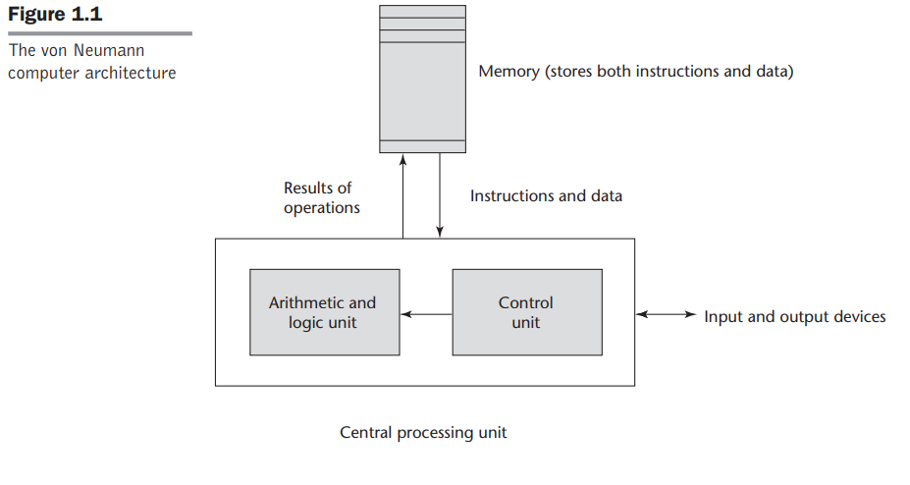

Slide 43
The execution of a machine code program on a von Neumann architecture computer occurs in a process called the fetch-execute cycle.
As stated earlier, programs reside in memory but are executed in the CPU.
Each instruction to be executed must be moved from memory to the processor.
The address of the next instruction to be executed is maintained in a register called the program counter.

Slide 44
The fetch-execute cycle can be simply described by the following algorithm:
initialize the program counter
repeat forever
fetch the instruction pointed to by the program counter
increment the program counter to point at the next instruction
decode the instruction
execute the instruction
end repeat

Slide 45
Programming Design Methodologies
An important reason for this research was the shift in the major cost of computing from hardware to software, as hardware costs decreased and programmer costs increased.
Increases in programmer productivity were relatively small.
In addition, progressively larger and more complex problems were being solved by computers
The new software development methodologies that emerged as a result of the research of the 1970s were called top-down design and stepwise refinement.

Slide 46
In the late 1970s, a shift from procedure-oriented to data-oriented program design methodologies began.
Data-oriented methods emphasize data design, focusing on the use of abstract data types to solve problems.
For data abstraction to be used effectively in software system design, it must be supported by the languages used for implementation.
The latest step in the evolution of data-oriented software development, which began in the early 1980s, is object-oriented design.
Object-oriented methodology begins with data abstraction, which encapsulates processing with data objects and controls access to data, and adds inheritance and dynamic method binding.

Slide 47
Inheritance is a powerful concept that greatly enhances the potential reuse of existing software, thereby providing the possibility of significant increases in software development productivity.
This is an important factor in the increase in popularity of object-oriented languages.

Slide 48
Language Categories
Imperative
– Central features are variables, assignment statements, and iteration
– Examples: C, Pascal
Functional
– Main means of making computations is by applying functions to given parameters
– Examples: LISP, Scheme
Logic
– Rule-based (rules are specified in no particular order)
– Example: Prolog

Slide 49
Object-oriented
– Data abstraction, inheritance, late binding
– Examples: Java, C++
Markup
– New; not a programming per se, but used to specify the layout of information
in Web documents
– Examples: XHTML, XML

Slide 50
Language Design Trade-Offs
The programming language evaluation criteria provides a framework for language design. But that framework is self-contradictory.
Reliability vs. cost of execution
Two criteria that conflict are reliability and cost of execution.
Example: Java demands all references to array elements be checked for proper indexing but that leads to increased execution costs when compared to C.
Readability vs. writability
Another conflicting criteria
Example: APL provides many powerful operators (and a large number of new symbols), allowing complex computations to be written in a compact program but at the cost of poor readability.

Slide 51
Writability (flexibility) vs. reliability
Another conflicting criteria
Example: C++ pointers are powerful and very flexible but not reliably used

Slide 52
Implementation Methods
Compilation
Programs are translated into machine language
Pure Interpretation
Programs are interpreted by another program known as an interpreter
Hybrid Implementation Systems
A compromise between compilers and pure interpreters

Slide 53
Compilation
Translate high-level program (source language) into machine code (machine
language)
Slow translation, fast execution
Compilation process has several phases:
lexical analysis: converts characters in the source program into lexical units
syntax analysis: transforms lexical units into parse trees which represent the syntactic structure of program
Semantics analysis: generate intermediate code
code generation: machine code is generated

Slide 54
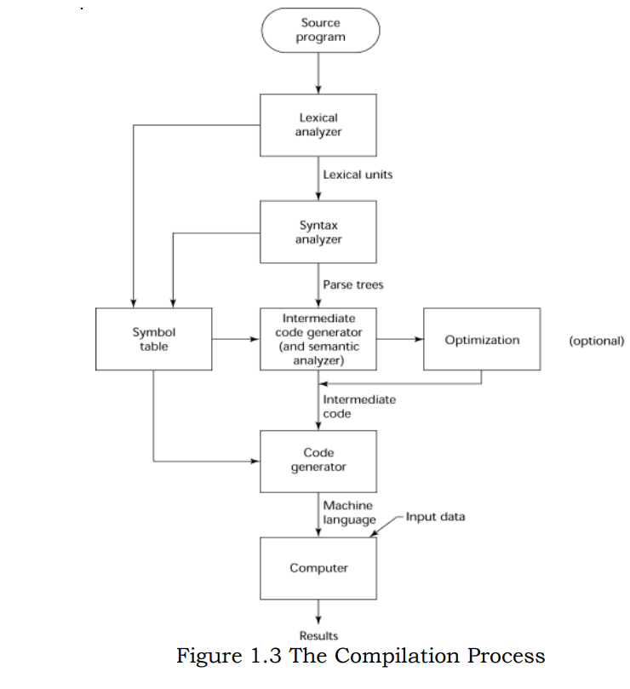

Slide 55
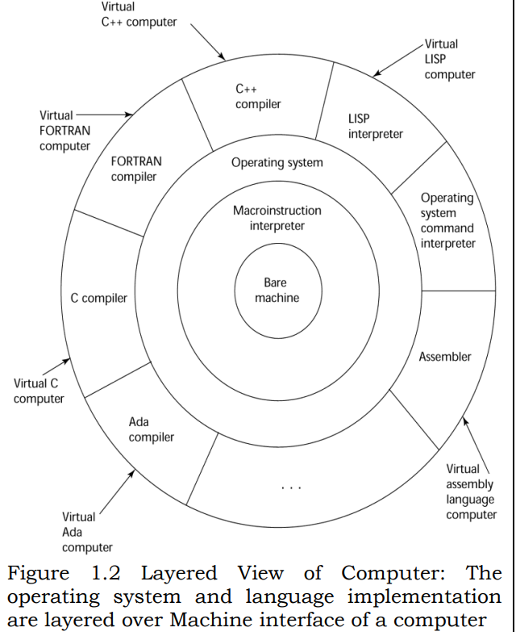

Slide 56
Additional Compilation Terminologies
Load module (executable image): the user and system code together is called load module.
Linking and loading: the process of collecting system program and linking them to user program

Slide 57
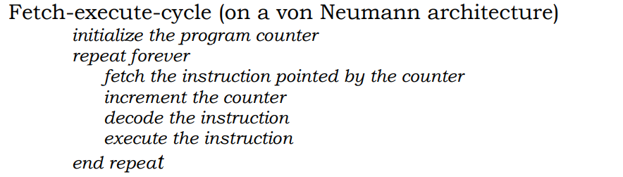
Execution of Machine Code

Slide 58
Von Neumann Bottleneck
Connection speed between a computer‘s memory and its processor determines the speed of a computer
Program instructions often can be executed a lot faster than the above connection speed;
the connection speed thus results in a bottleneck known as von Neumann bottleneck;
it is the primary limiting factor in the speed of computers

Slide 59
Pure Interpretation
Programs are interpreted by another program called an interpreter, with no translation whatever
Pure interpretation has the advantage of allowing easy implementation of many source-level debugging operations, because all run-time error messages can refer to source-level units.
For example, if an array index is found to be out of range, the error message can easily indicate the source line and the name of the array.
This method has the serious disadvantage that execution is 10 to 100 times slower than in compiled systems.

Slide 60
The primary source of this slowness is the decoding of the high-level language statements, which are far more complex than machine language instructions
Regardless of how many times a statement is executed, it must be decoded every time
Another disadvantage of pure interpretation is that it often requires more space.
In addition to the source program, the symbol table must be present during interpretation. Furthermore, the source program may be stored in a form designed for easy access and modification rather than one that provides for minimal size.

Slide 61
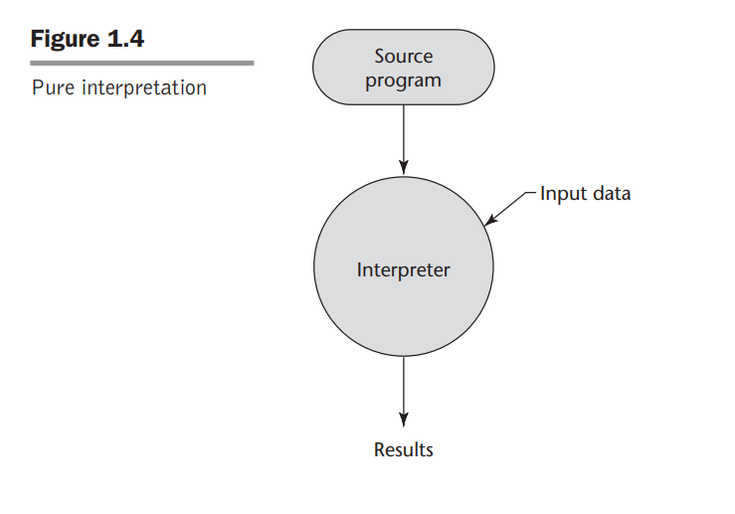

Slide 62
Hybrid Implementation Systems
Some language implementation systems are a compromise between compilers and pure interpreters;
They translate high-level language programs to an intermediate language designed to allow easy interpretation.
This method is faster than pure interpretation because the source language statements are decoded only once. Such implementations are called hybrid implementation systems

Slide 63
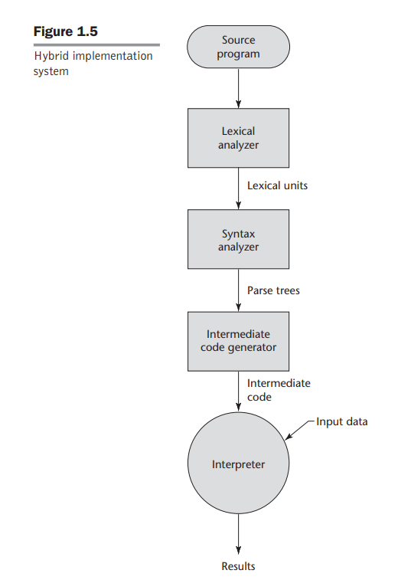

Slide 64
Perl is implemented with a hybrid system. Perl programs are partially compiled to detect errors before interpretation and to simplify the interpreter
Initial implementations of Java were all hybrid. Its intermediate form, called byte code, provides portability to any machine that has a byte code interpreter and an associated run-time system.
Together, these are called the Java Virtual Machine. There are now systems that translate Java byte code into machine code for faster execution.

Slide 65
A Just-in-Time (JIT) implementation system initially translates programs to an intermediate language.
Then, during execution, it compiles intermediate language methods into machine code when they are called. The machine code version is kept for subsequent calls.
JIT systems are now widely used for J.ava program~aq@ !`

Slide 66
Preprocessors
Preprocessor macros (instructions) are commonly used to specify that code from another file is to be included
A preprocessor processes a program immediately before the program is compiled to expand embedded preprocessor macros
Preprocessor instructions are embedded in programs. The preprocessor is essentially a macro expander.
A well-known example: C preprocessor
– #include "myLib.h" causes the preprocessor to copy the contents of myLib.h into the program at the position of the #include.

Slide 67
